Slide 1

GOOD MORNING!
Welcome to our class!

Slide 2



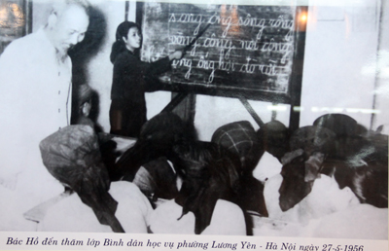
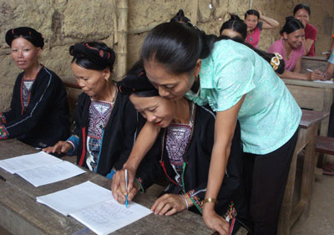




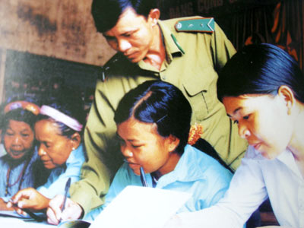

FRIDAY,OCTOBER 22nd, 2010 ENGLISH 11 Unit 5: ILLITERACY
31. E. LANGUAGE FOCUS
WARMLY WELCOME TO OUR CLASS 11 A1

Slide 3

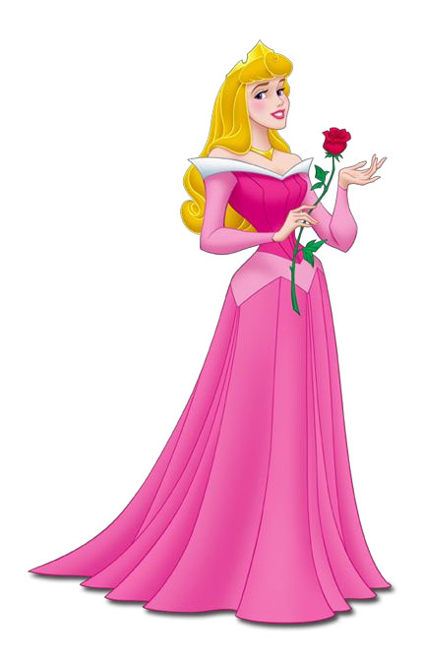

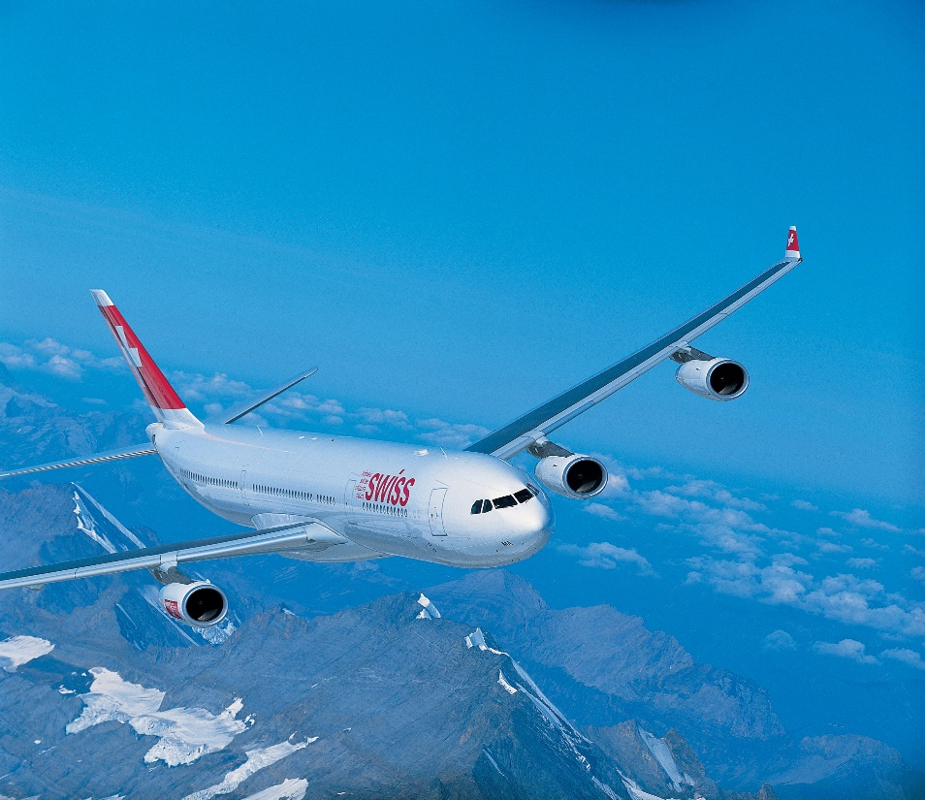

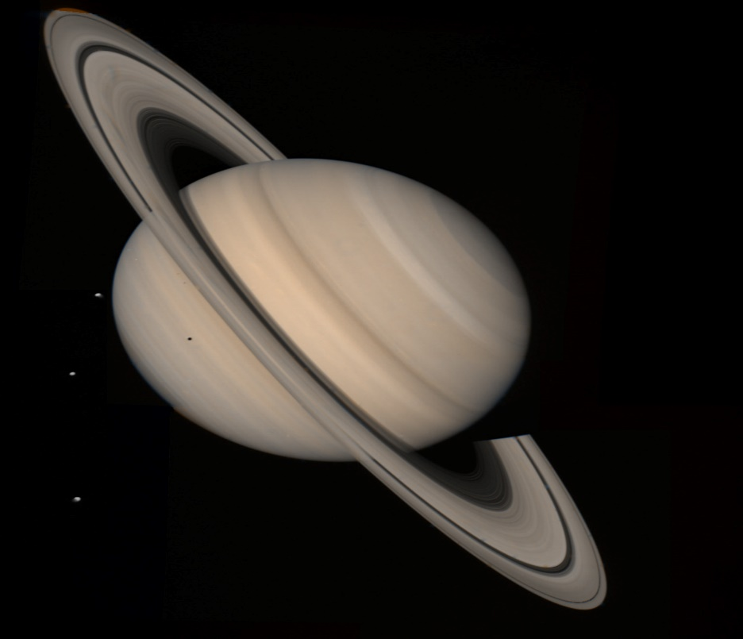
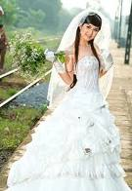

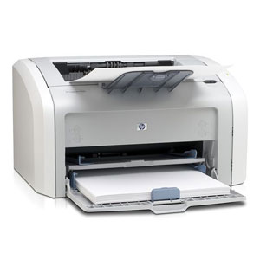
Warm –up : Game - Who is the quickest ?
-Look at 8 pictures illustrating 8 words in 1 minute
One student by one student of each group
type the words in the chat box in 1 minute.
-Which group has the most words is the winner.
BREAD
BLOUSE
PLANET
BRIDE
PLANE
PRESENT
PRINCESS
PRINTER

Slide 4

Warm –up : Game - Who is the quickest ?
Trying to write down as many English names as
possible through pictures on the screen.
Time is 1 minute

Slide 5

BREAD
BLOUSE
PLANET
PRINCESS

Slide 6

BRIDE
PRESENT
PRINTER
PLANE

Slide 7
Consonant clusters
/pl/ | /bl/ | /pr/ | /br/
plane | blouse | princess | bride
planet |  | present | bread
 |  | printer

Slide 8

Unit 5: Illiteracy
Part E:
Language focus

Slide 9

(I) PRONUNCIATION
/pl/ | /bl/ | /pr/ | /br/
please | black | pride | brown
pleasure | blouse | pretty | bread
play | blue | precious | brother
plenty | blow | practice | broad

Slide 10
Practice reading aloud the dialogue.
A: Brian, what is Bretty presenting on Sunday ?
B:She’ll teach us how to play English pronunciation
games.
A: Are you going to prepare for it ?
B: Yes. My mother is going to play the guitar and I’ll
sing the blues.
A: What clothes are you going to wear, Pretty ?
B: Black brown blouse and jeans.
A: How about a small present for Bretty after her
presentation ?
B: Please bring something not very precious.

Slide 11

Stop by that house!
Reported Speech
with to-infinitive
What did the teacher ask her students to do?
She asked her students to stop
by that house.
to-infinitive

Slide 12
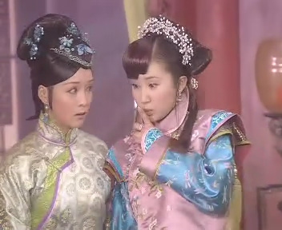
(II)GRAMMAR:REPORTED SPEECH WITH INFINITIVE(S)
“Keep quiet,” she said to her sister .
What did she tell her sister?
=> She told her sister to keep quiet.

Slide 13
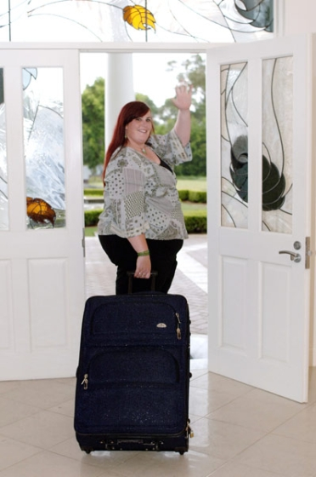
Bye! See you soon, Lan!
What did she hope to do?
She hoped to see Lan soon.

Slide 14
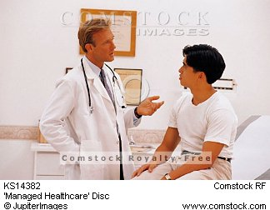
“You should give up smoking,” the doctor said to his patient.
What did the doctor advise his patient ?
=>The doctor advised his patient to give up smoking .

Slide 15


“I’ll buy you a computer tomorrow,” He said to his daughter.
What did he promise to do ?
=> He promised to buy his daughter a computer the day after

Slide 16
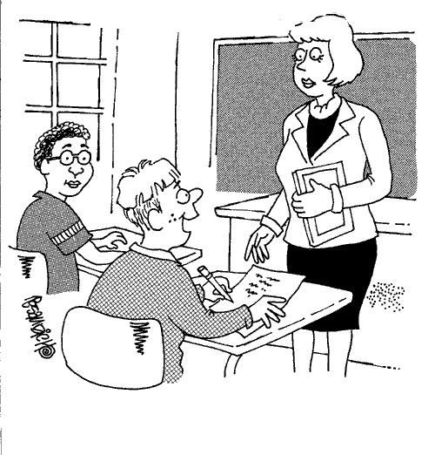
“Remember to do your homework when you are free today , Tom” the teacher said .
=> The teacher reminded Tom to do his homework when he was free that day.

Slide 17
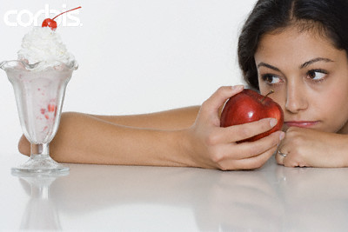
I want ice-cream.
What did she want to eat?
She wanted to eat ice-cream.
to V

Slide 18
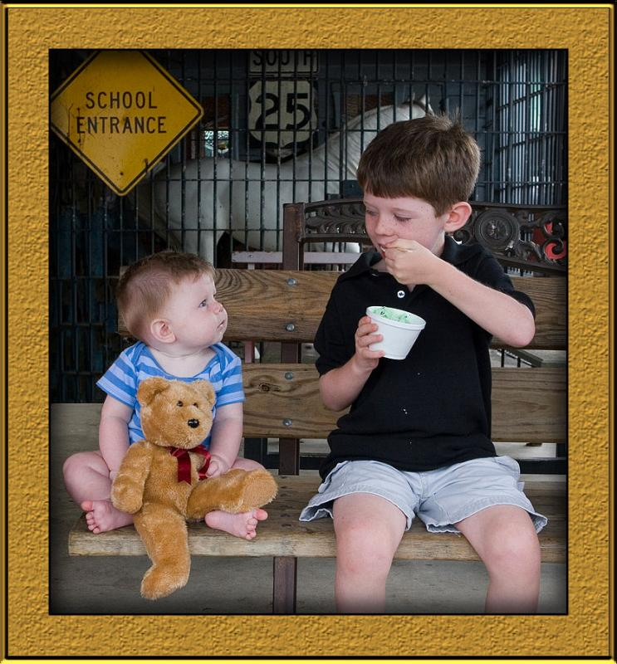
I like ice-cream, too.
What did the baby boy want his brother to do?
The baby boy wanted his brother to give him ice-cream. Obj to V

Slide 19
REPORTED SPEECH (REVISION)
1. Định nghĩa:
- Lời nói gián tiếp (indirect / reported speech) là lời tường thuật lại ý của người nói.
Ex. The farmer says: “I hope it will rain tomorrow.”
→The farmer says that he hopes it will rain tomorrow.
(Ta không đổi các yếu tố về thì, thời gian, nơi chốn khi động từ tường thuật ở thì hiện tại)
* Khi động từ tường thuật ở thì quá khứ:
Lưu ý: said => said that
said to => told that

Slide 20
2. Các thay đổi trong câu gián tiếp.
2.1. Thay đổi về thì: (TENSES)
Lưu ý: Ta có thể dùng thì “Simple present” thay vì “Simple past” trong lời nói gián tiếp khi diễn tả một thói quen hoặc một chân lý.
Ex. The teacher said: “The sun rises in the East.”
→The teacher said that the sun rises/rose in the East.

Slide 21
Direct speech (Trực tiếp) | Indirect speech (Gián tiếp) | Examples (Ví dụ)
Simple present (HTĐ) V_{1/s/es} don’t/doesn’t + V₁ am/is/are + … | Simple past (QKĐ) V_{2/d/ed} didn’t + V₁ was/were + … | Tom said: “I feel sick.” Tom said (that) he felt sick. She said: “I am at home today.” →She said that she was at home that day.
Present continuous am/is/are + (not) + V-ing | Past continuous was/were + (not) + V-ing | Tom said: “I am writing a letter.” →Tom said that he was writing a letter.
Simple past (QKĐ) V_{2/d/ed} didn’t + V₁ | Past perfect (QKHT) had/hadn’t + V_{3/ed} | She said to me: “I arrived at 5 p.m” →She told me that she had arrived at 5 p.m
Present perfect (HTHT) have/has + V_{3/ed} | Past perfect (QKHT) had/hadn’t + V_{3/ed} | They said: “We have seen this film.” →They said that they had seen that film.

Slide 22
Direct speech (Trực tiếp) | Indirect speech (Gián tiếp) | Examples (Ví dụ)
Past perfect had/hadn’t + V_{3/ed} | Past perfect had/hadn’t + V_{3/ed} | Mary said: “I had told him about it.” →Mary said that she had told him about it.
Past continuous (QKTD) was/were + (not) + V-ing | Past perfect continuous (QKHT TD) had/hadn’t + been + V-ing | He said: “I was doing my homework at that time.” →He said that he had been doing his homework at that time.
Simple future (TLĐ) will/ won’t + V₁ | Future in the past would/wouldn’t + V₁ | She said: “I will call my mom.” →She said that she would call her mom.

Slide 23
Direct speech (Trực tiếp) | Indirect speech (Gián tiếp) | Examples (Ví dụ)
am/is/are going to V | was/were going to V | She said: “I am going to buy a new house.” →She said that she was going to buy a new house.
Modal verbs must→ can→ may→ shall→ | had to could might should | Peter said: “I must go out as soon as possible.” →Peter said that he had to go out as soon as possible.”

Slide 24
2.2. Thay đổi về thời gian và nơi chốn (TIME AND PLACES)
Direct speech (Trực tiếp) | Indirect speech (Gián tiếp) | Examples (Ví dụ)
this | that | Tom said: “I need this book.” Tom said that he needed that book
these | those | Mary said: I’ll take these books with me.” Mary said that she would take those books with her.
here | there | Anna said: “I will put it here.” Anna said that she would put it there.
now | then | Tom said: “I am doing my homework now.” Tom said that he was doing his homework then.

Slide 25
2.2. Thay đổi về thời gian và nơi chốn (TIME AND PLACES)
Direct speech (Trực tiếp) | Indirect speech (Gián tiếp) | Examples (Ví dụ)
today | that day | Anna said: “I feel happy today.’ Anna said that she felt happy that day.
yesterday | the day before the previous day | Mary said: “I was in Hue yesterday.” Mary said that she had been in Hue the day before.
tomorrow | the next day the following day the day after | They said: “We will wait for you until tomorrow.” They said that they would wait for me until the day after.
ago | before | Tom said: “I painted the house 3 hours ago.” Tom said that he had painted the house 3 hours before.
next week | the week after the following week | The teacher said: “I am going to teach this lesson next week.” The teacher said that he/she was going to teach that lesson the week after.

Slide 26
3. Cách đổi từ câu trực tiếp sang gián tiếp:
3.1 Câu mệnh lệnh và câu yêu cầu (orders and requests)
Ex. He said: “Hurry up, Lan”
→He told Lan to hurry up.
Ex.: He said: “Please don’t tell anybody what happened.”
→He told me not to tell anybody what had happened.
➔Câu mệnh lệnh và yêu cầu, đề nghị được đổi từ trực tiếp sang gián tiếp thường được mở đầu bằng những động từ như: order, command, tell, ask, request, … và theo sau là tân ngữ trực tiếp chỉ người nhận lệnh + động từ nguyên mẫu (object + to – infinitive)

Slide 27
3.2 Câu hỏi (Questions)
Có 2 loại câu hỏi: Yes/No Questions và W/h Questions
3.2 a. Yes/No Questions
Quy tắc:
Dùng “if” hoặc “whether” ngay sau động từ giới thiệu của mệnh đề chính.
Đổi trật tự của câu hỏi thành câu trần thuật và đổi các đại từ, tính từ, thì của động từ, …
Ex. He asked her: “Have you seen that film?”
→He asked her if/ whether I had seen that film.
Ex. She wondered: “Will Tom be here tomorrow?”
→ She wondered if/whether Tom would be there the day after.

Slide 28
3.2 b. W/h Questions: (bắt đầu bằng những từ để hỏi là W/h)
Quy tắc:
Lặp lại từ để hỏi (what, when, how, why, …) sau động từ giới thiệu.
Đổi trật tự câu hỏi thành câu trần thuật và đổi các đại từ, tính từ, thì của động từ, …
Ex. He asked me: “What time does the film begin?”
→He asked me what time the film began.
Ex. Tom asked: “What will happen if she cannot find her passport?”
→Tom asked what would happen if she couldn’t find her passport.

Slide 29
Lưu ý:
Trong trường hợp câu trực tiếp có cả câu trần thuật lẫn câu hỏi thì khi đổi sang câu gián tiếp, phần nào thì vẫn cứ đổi phần ấy.
Ex. He said: “I have left my watch at home. Can you tell me the time?”
He said that he had left his watch at home and asked me if I could tell him the time.

Slide 30
3.3 Câu cảm thán (exclamation)
Ex. “What a lovely garden they have.” – He said
→He said that what a lovely garden they had.
3.4 Câu trần thuật (statements)
Quy tắc:
Đổi các đại từ nhân xưng, tính từm đại từ sở hữu sao cho tương ứng với chủ ngữ hoặc tân ngữ mệnh đề chính.
Đổi thì của động từ thành thì của quá khứ tương ứng.
Đổi một số tính từ chỉ thời gian, nơi chốn, tính từ chỉ định.
Ex. Peter said to Lan: “I saw my best friend yesterday.
→Peter told Lan that he had seen his best friend the day before.

Slide 31
3.5 Câu trần thuật theo sau là to-infinitive
1. REPORTED VERBS + TO infinitive (to-v)
agree : đồng ý demand : yêu cầu offer : đề nghị promise : hứa refuse : từ chối threaten : đe dọa claim : quả quyết ask : yêu cầu …. | He said: “I will do it again.” →He agreed to do it again. He said: “I will give you all money on Friday.” →He promised to give me all money on Friday. “Shall I carry your bags.” – He said →He offered to carry my bags.

Slide 32
2. REPORTED VERBS + O + TO-infinitive (to V)
advise O to V :khuyên encourage O to V : khuyến khích allow O to V : cho phép ask O to V : yêu cầu beg O to V : nài nỉ command O to V : ra lệnh forbid O to V : cấm instruct O to V : hướng dẫn invite O to V : mời order O to V : yêu cầu permit O to V : cho phép remind O to V : nhắc urge O to V : thúc giục warn O (not) to V : cảnh báo want O to V : muốn | *He said: “Mary should know that we are here now.” →He wanted Mary to know that they were there then. *Joe said: “Please come to my party.” →Joe invited me to come to his party. *My teacher said: “I think you should take another English course.” →My teacher advised me to take another English course. * The doctor said to the patient: “Take a deep breath.” →The doctor told the patient to take a deep breath.

Slide 33
 | Trực tiếp | Gián tiếp
Subjects pronouns | I | He/She
 | You | I / We / They
 | We | We / They
Object pronouns | me | him / her
 | you | me / us / them
 | us | us / them
Possessive adjectives | my | his / her
 | your | my / our / their
 | our | our / their
Possessive pronouns | mine | his / hers
 | yours | mine / ours / theirs
 | ours | ours / theirs
Demonstratives | this | that
 | these | those

Slide 34
Exercise 1: Complete the second sentence so that it has a similar meaning to the first one, using the words given:
1.“We’ll come back again.”
→ They promised…………………………
2. “You’d better not swim too far from the shore,”
→The lifeguard advised…………………………….…
3. “Could you close the window?”
→John asked…………………………………
4. “You should join the football team, Eric,” said the teacher.
→The teacher encouraged………………………………
to come back again.
us not to swim too far from the shore.
Peter to close the window.
Eric to join the football team.

Slide 35
5. “I’ll give it to him tomorrow,” John said.
→John promised…………………………………
6. “I’d like Lan to become a doctor,”my mum said.
→My mum wanted ………………………………
7. “Remember to lock the door before going to school,” my sister said.
→My sister reminded…………………………………………
8. “You should go home and rest rof a while,”said the boss.
→His boss advised…………………………………….
to give it to him the day after.
Lan to become a doctor.
me to lock the door before going to school.
him to go home and rest for a while.

Slide 36
Practice: Exercise 1 (textbook, page 64)
IV. Practice:
1. Exercise 1 (textbook, page 64)
1. We’ll come back again.”
They promised to come back again.
2. “You’d better not swim too far from the shore,” the lifeguard said to us
The lifeguard advised us not to swim too far from the shore.
3. “Could you close the window?” John said to Peter.
John asked Peter to close the window.
4. “You should join the football team, Eric,” said the teacher.
The teacher encouraged Eric to join the football team.
5. “ I’ll give it to him tomorrow,” John said
John promised to give it to him the next day/ the day after.
6. “I’d like Lan to become a doctor,” my mum said.
My mum wanted me to become a doctor.
8. You should go home and rest for a while,” said the boss
His boss advised him to go home and rest for a while.

Slide 37
Exercise 2: Report these statements, using the correct form of the verbs given in the brackets.
She said to him, “Ok. I’ll help you.” (AGREE)
→ She agreed to help him.

Slide 38

Sentence 1
“You should not drink too much beer.” (ADVISE)
→ He advised me not to drink to much beer.

Slide 39
Sentence 2
“Come and see me whenever you want”
( INVITE)
→ She invited me to come and see her whenever I want

Slide 40

Sentence 3
“Please don’t smoke in my car” ( ASK)
-> He ( Tom) asked me not to smoke in his car.

Slide 41

Sentence 4
“Sue, give me your phone number,” (TELL)
→ He told Sue to give him her phone number.

Slide 42

Sentence 5
“Don’t forget to give the book back to Joe.”
( REMIND)
→ He reminded me to give the book back to Joe.

Slide 43

Sentence 6
“I’ll never do it again.” ( PROMISE)
→ Peter / He promised not to do it again

Slide 44

Sentence 7
“All right, I’ll wait for you.” (AGREE)
-> He / She agreed to wait for me

Slide 45

Sentence 8
“Please, lend me some money.” (ASK)
-> He asked me to lend him some money.

Slide 46
Extra exercises
I. Reorder the words to build a meaningful sentence
1. to / me / invited / movies / to / John / the / go
II. Choose the best answer a, b, c or d
2. “ Don’t forget to post the letter” He…...me to post the letter.
a. ordered b. reminded c. warned d. promised
3. She told me………
a. shut the door but don’t lock it b. shut the door but not lock it
c. to shut the door but not lock it d. to shut the door but not to lock it
4. “ You’d better ask your parents for permission”
Mary advised Peter …………..
a. ask his parents for permission
b. had better ask his parents for permission
c. to ask his parents for permission
d. to ask better his parents for permission

Slide 47
ANSWER KEY
I . Reorder the words to build a meaningful sentence
1. John invited me to go to the movies
Choose the best answer a, b, c or d
2. “ Don’t forget to post the letter” He…...me to post the letter.
a. ordered b. reminded c. warned d. promised
3. She told me………
a. shut the door but don’t lock it b. shut the door but not lock it
c. to shut the door but not lock it d. to shut the door but not to lock it
4. “ You’d better ask your parents for permission”
Mary advised Peter …………..
a. ask his parents for permission
b. had better ask his parents for permission
c. to ask his parents for permission
d. to ask better his parents for permission
b
d
c

Slide 48

Do all exercises in workbook
( section: Language focus)
2. Prepare Unit 6- Reading

Slide 49




Thank you for joining us.
GOODBYE !
SEE YOU AGAIN .

